Slide 1
Twitter Application: a 3-Iteration Rapid Prototyping Project
Nathan Hammes, Yeshwanthi Pasupuleti, Geetha Satyanarayana, and Akshay Virkud
December 10th, 2014

Slide 2
Metrics - Requirements
Prioritization
Self-completeness
Traceability

Slide 3
Metrics – Design
Coupling
Flexibility
Reusability

Slide 4
Metrics - Implementation
Understandability
Robustness
Security
Code Coverage

Slide 5
Iterations
Initial Prototyping Phase
Feature Additions to Prototypes
Final Features Added/Live AWS deployment

Slide 6
Iteration 1 Prototypes and Requirements

Slide 7
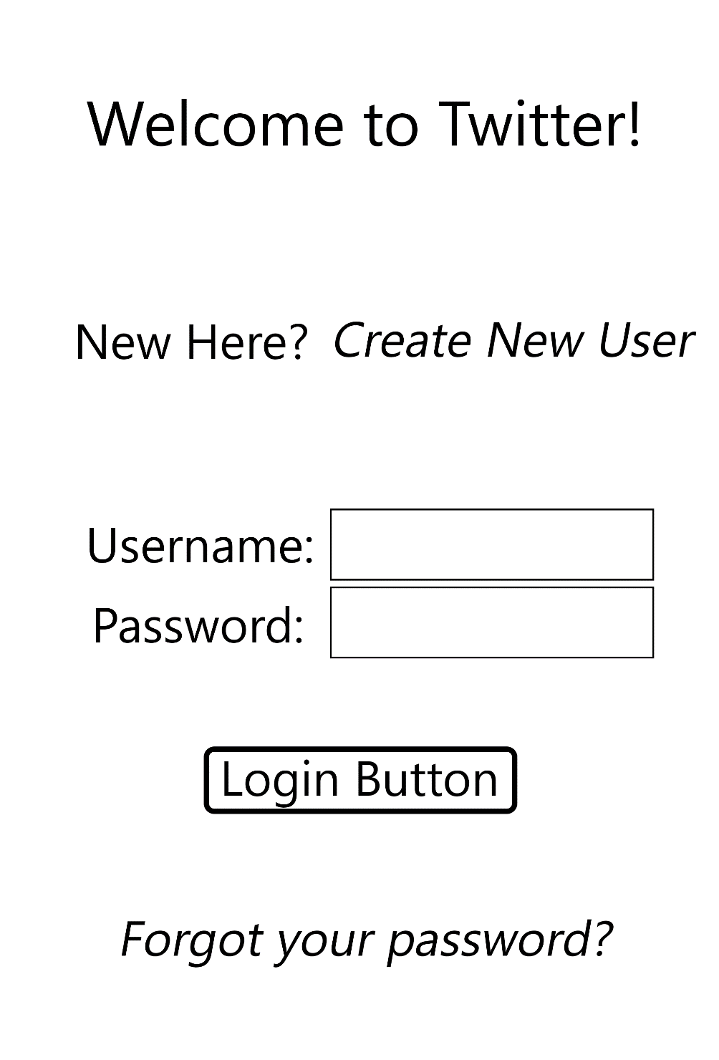
Login Page

Slide 8
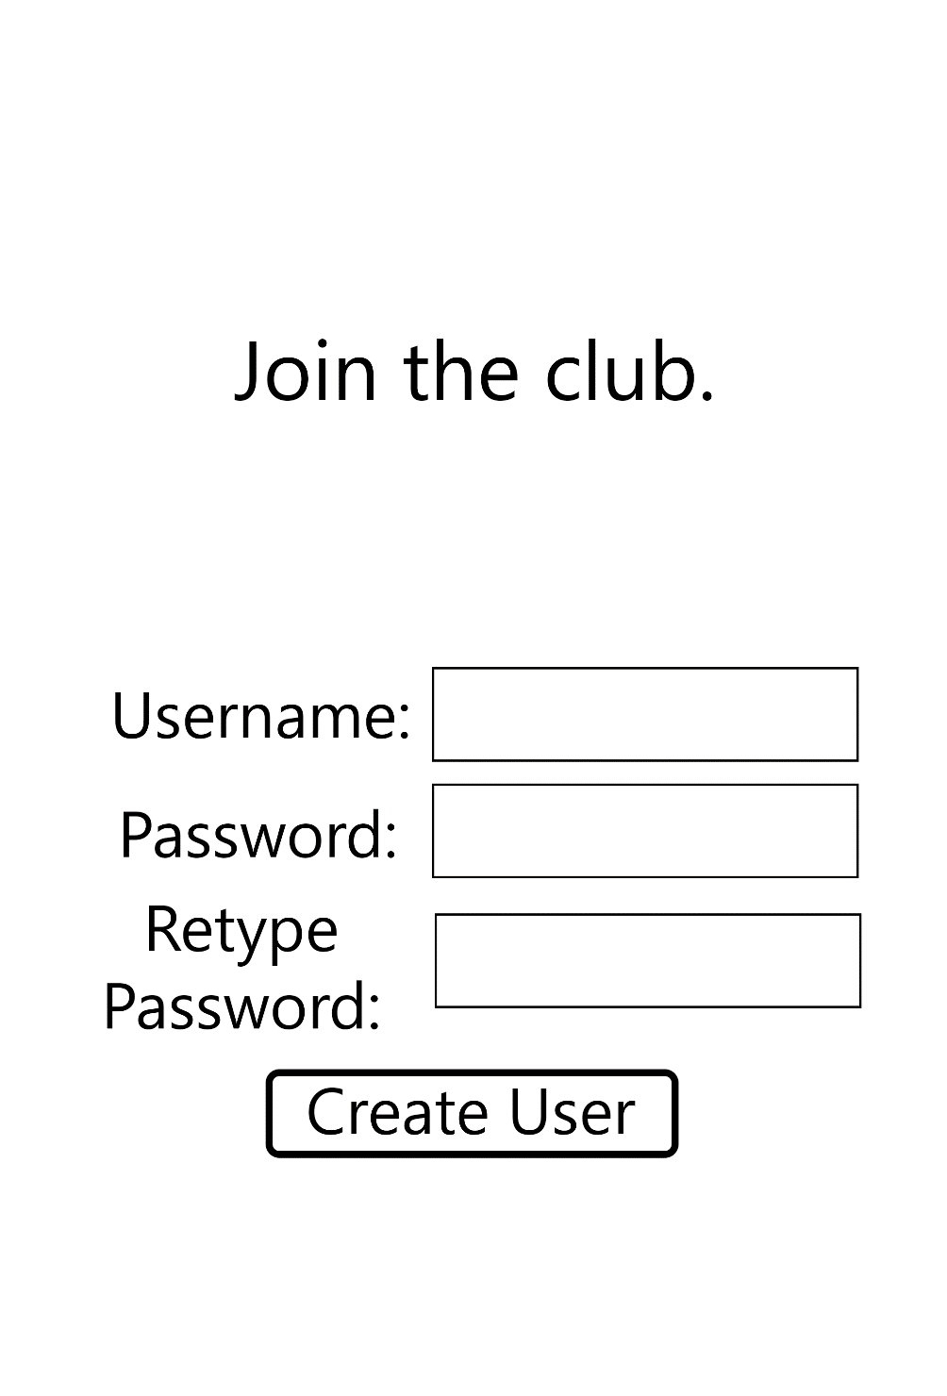
Create New User Page

Slide 9
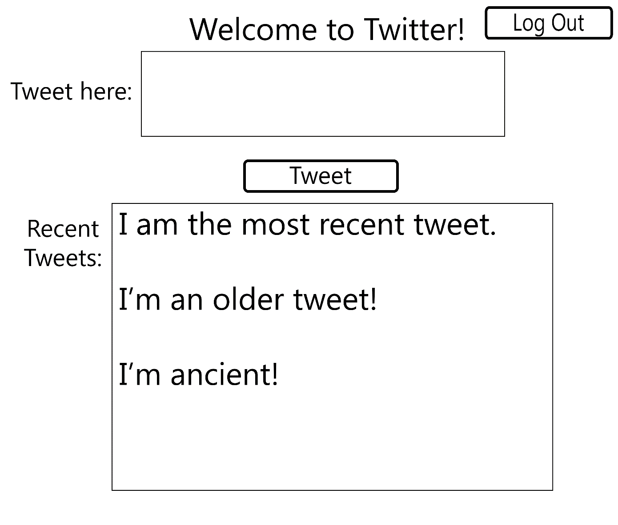
Home Page

Slide 10
Iteration 1 Design

Slide 11
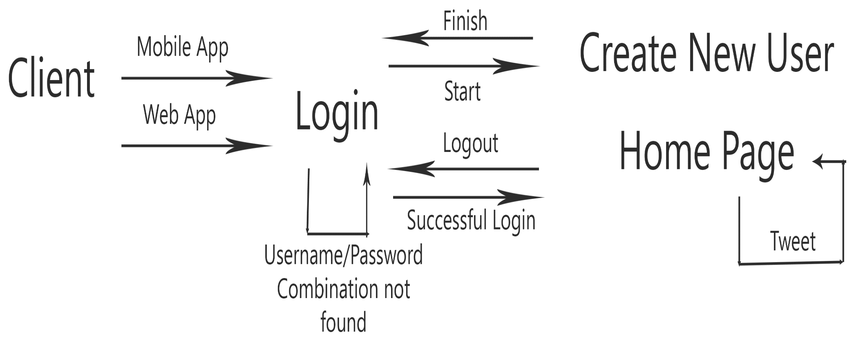
Flow Diagram

Slide 12
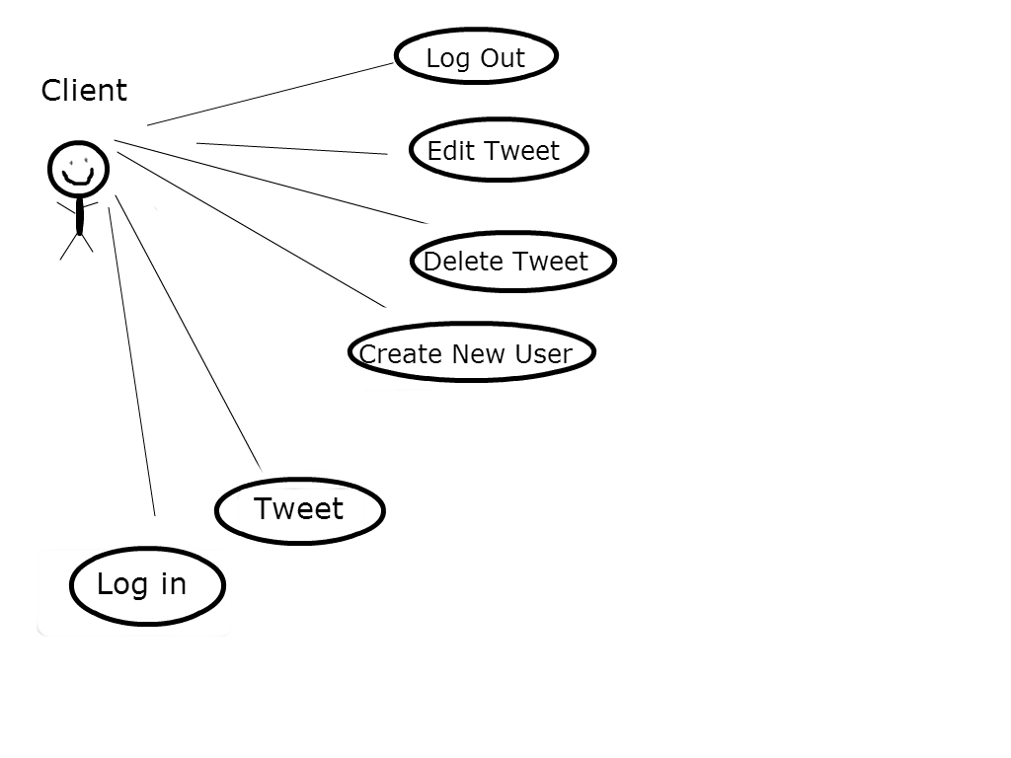
Use Case Diagram

Slide 13
Iteration 1 Implementation

Slide 14
Login Page

Slide 15
Create New User Page

Slide 16
Home Page

Slide 17
Iteration 1 Difficulties
Choice of technology to use

Slide 18
Iteration 2 Requirements

Slide 19
Iteration 2 Design

Slide 20
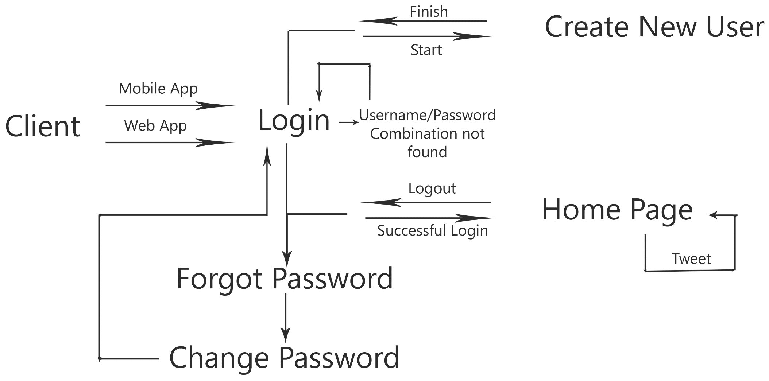
Flow Diagram

Slide 21
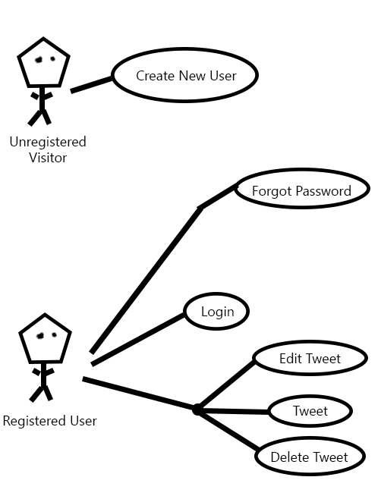
Use Case Diagram

Slide 22
Iteration 2 Implementation

Slide 23
Iteration 2 Difficulties
Integration of SQLite database

Slide 24
Iteration 3 Requirements

Slide 25
Iteration 3 Design

Slide 26
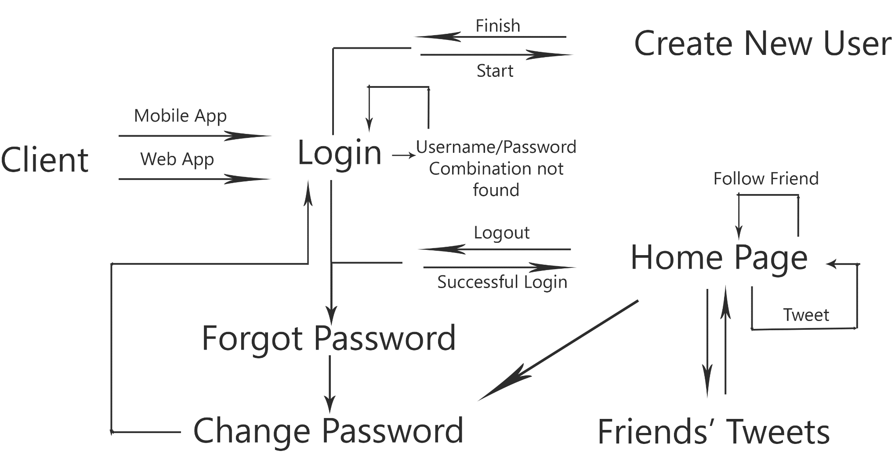
Flow Diagram

Slide 27
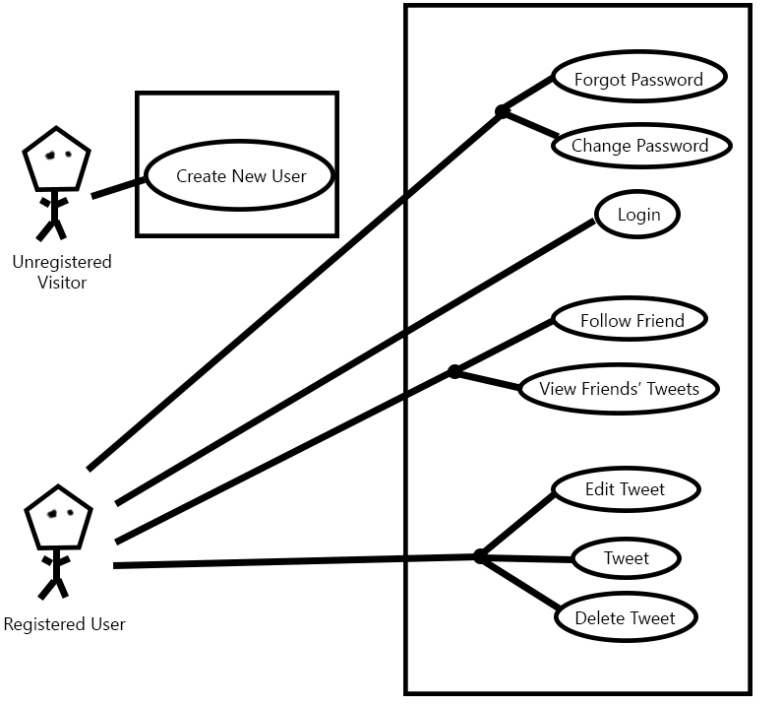
Use Case Diagram

Slide 28
Iteration 3 Implementation

Slide 29
Requirements Metrics and Trends
Prioritization
Self-completeness
Traceability

Slide 30
Design Metrics and Trends
Coupling
Flexibility
Reusability

Slide 31
Implementation Metrics and Trends
Understandability
Robustness
Security
Code Coverage

Slide 32
Final Mention of Difficulties

Slide 33
Demonstration
Web Tweet
Mobile Tweet
Creating a New User
Finding Some Friends
Viewing Friends’ Tweets

